Slide 1
Clean coal technology
by Maria pompa, Gerardo,Karl Gudino, Ottoniel Ticas

Slide 2
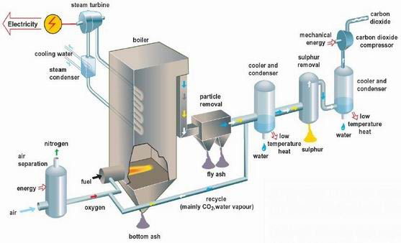
METHODS & PROCESSES
Clean coal technology improves the environmental performance of coal-based electricity plants
It includes devices that increase the operational efficiency of a power plant
It is focused to reduce traditional pollutant emissions such as sulfur dioxide and nitrogen oxides, which are a precursor to smog and particulate matter

Slide 3
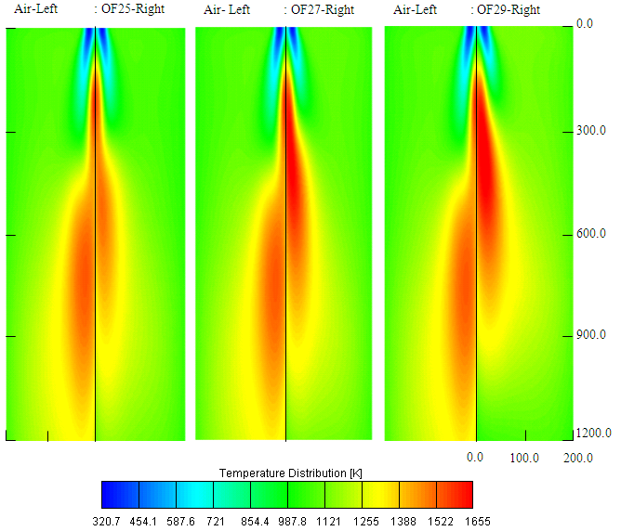
TYPES OF FOSSIL FUELS
Coal
Flue Gas
Greenhouse Gas
Water

Slide 4
Pros
Cons
Coal helps generate about half of the electricity in United States
Nation’s largest source of global warming pollution
Potential to combine wit biomass-fueled power, where plants would feed on carbon to create power source
Coal is the dirtiest of all fossil fuels
The cost could easily increase the cost of energy from pulverized coal plant by two-thirds to three quarters
Being dependent on a nonrenewable resource for energy
Risk of leaks from pipelines or storage facilities carrying the concentrated gas can be fatal

Slide 5
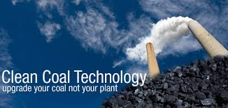
pristine-m
CCTI’s Pristine M technology is a patented, low-cost coal dehydration technology. The process begins with the extraction of volatile material in liquid form from lower ranking coals. Once the moisture is removed from the targeted coal, the liquids are used through an “absorption” process to fill the pores of the coal that has been dehydrated. The end result is an impermeable, stable coal with an upgraded BTU.

Slide 6
pristine-sa
Pristine-SA, is a development stage technology designed to eliminate 100% of the volatile material in feed coal. To achieve stable combustion, Pristine-SA would be co-fired with treated biomass or natural gas. The process would result in a clean fuel, eliminating the need for emissions scrubbers and the corollary production of toxic FGD sludge.

Slide 7
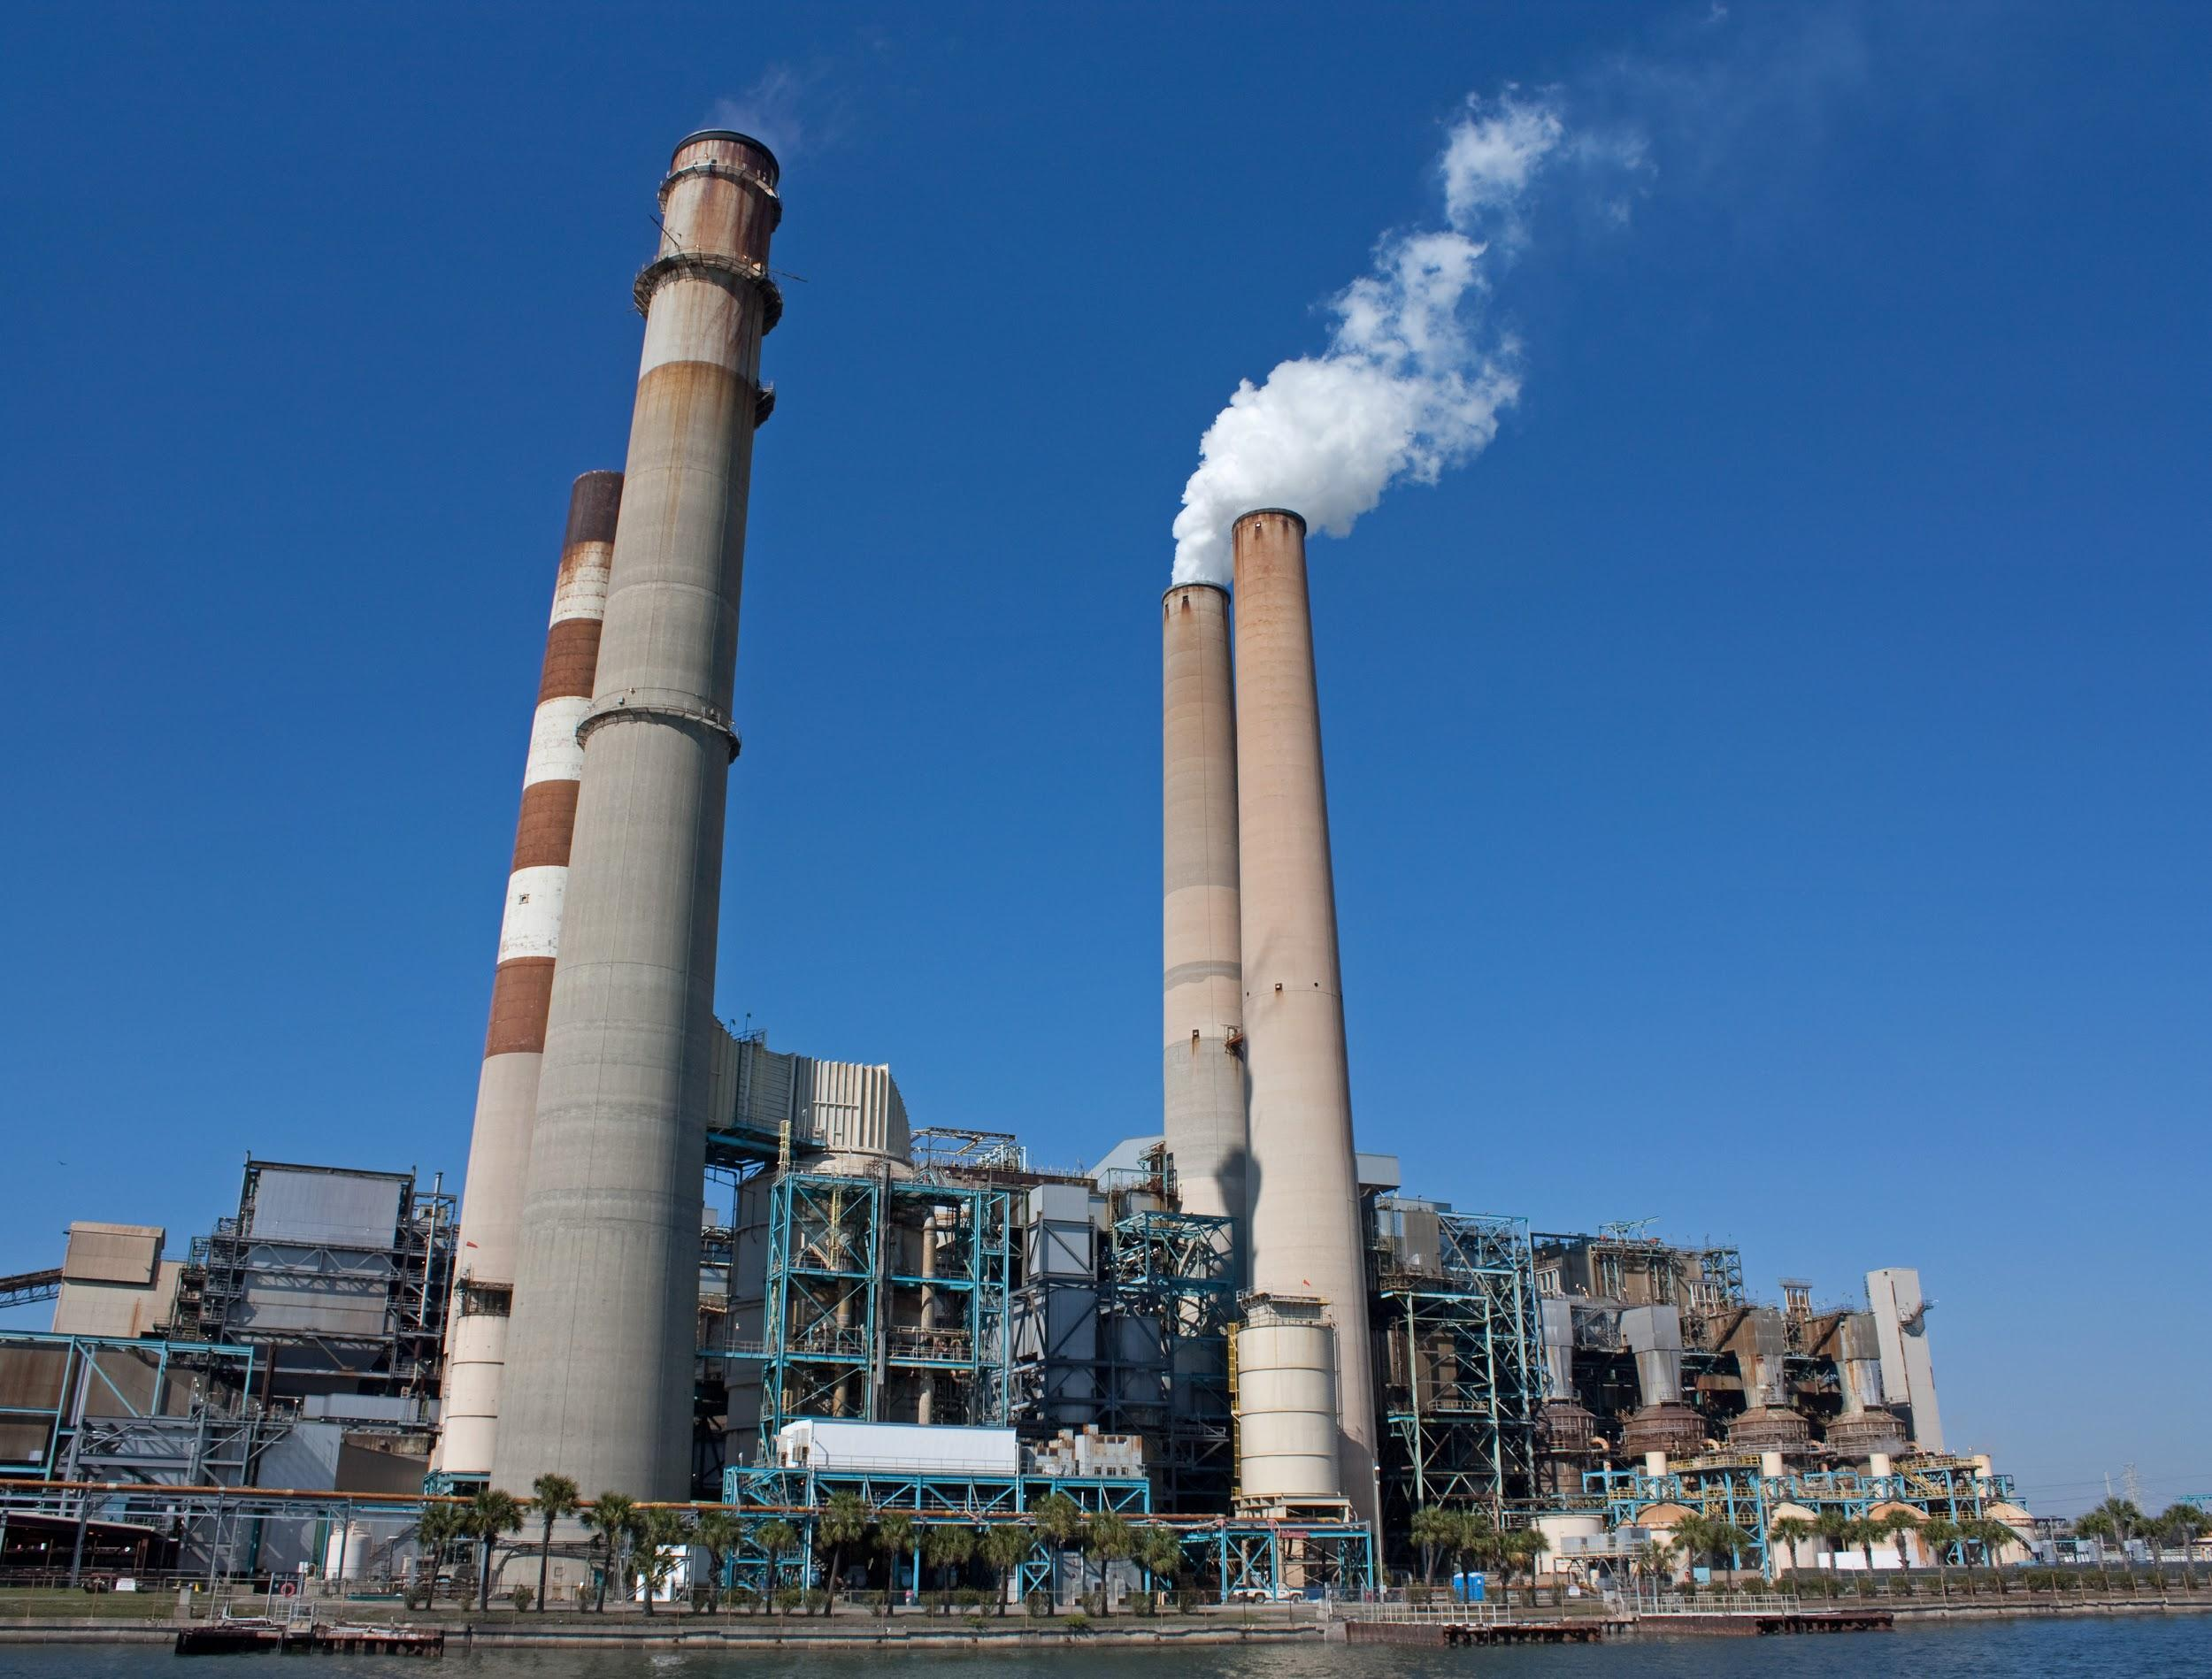
Pristine™
CCTI’s legacy technology, Pristine™, is designed to remove moisture and volatile matter (VM), as per client-specified requirements. boiler design and the need for a certain amount of volatile material to remain in the coal to ensure proper burn. The end product is a cleaner burning, dry coal.

Slide 8
Waste management
Coal cleaning by 'washing' has been standard practice in developed countries for some time. It reduces emissions of ash and sulfur dioxide when the coal is burned.
Ultra-clean coal (UCC) from new processing technologies which reduce ash below 0.25% and sulfur to very low levels mean that pulverised coal might be used as fuel for very large marine engines, in place of heavy fuel oil. There are at least two UCC technologies under development. Wastes from UCC are likely to be a problem

Slide 10
BIBLIOGRAPHY/SOURCES
Choi, Charles Q. "The Energy Debates: Clean Coal." Live Science. Live Science, 05 Dec. 2008. Web.
"Coal Technology Now." America's Power. N.p., n.d. Web.
"Our Commitment to a Clean Energy Future: Clean Coal Technology."America's Power. N.p., n.d. Web.
Brewer, Reuben Gregg. "Clean Coal Technology Is a Necessity & These 3 Companies Know It." The Motley Fool. N.p., 02 Jan. 2014. Web.
"Homepage." Clean Coal Technologies. N.p., 05 June 2015. Web. 02 Nov. 2015.
"World Nuclear Association." Clean Coal Technologies. N.p., n.d. Web. 02 Nov. 2015.

